Slide 1
Attachment of ICT usage as observed during visit to Industry/Business Enterprise

Slide 2
Company Name : Nascenia
Date of Visit : 14 August, 2014
Location : House 6/14,
Block A,
Lalmatia, Dhaka-1207.
Group Members :
NAME | ROLL
Ashfaqur Rahman Tokee | 192339
MD. Shakil Hossain | 192340
Mahabubur Rahman | 192341
Nahidul Islam | 192345

Slide 3
CONTENTS
Company Overview
Software Development Process
Learnings
Achievements

Slide 4
About Nascenia
Nascenia is a privately held company providing software solutions worldwide
The company was formed in 2011.
Nascenia has worked in 21 countries in over 110 project and contains over 40 employees.
The company has clients in Bangladesh, India, Hong Kong, USA, UK, Japan, Australia and many other countries in Europe.

Slide 5
Achievements
Nascenia has won multiple prestigious awards over the years for their works.
BASIS outsourcing award winner 2015 and 2014
2013 Red Herring top 100 Asia winner
2012 Red Herring top Asia finalist
eAsia ( www.e-asia.org ) award winner in 2011
Grameen Phone - Microsoft Alo Asbei award winner in 2010

Slide 6
Services
Web Development
Ruby on Rails
PHP
.Net
AngularJS, ReactJS
NodeJS
Magento
Mobile Development
Android
iOS
Hybrid
UI/UX Design
Requirement Generation
Wireframing
Design for Web and Mobile

Slide 7
Services
Cutting Edge
Blockchain
IBM Watson
Facial Recognition
Big Data
Natural Language Processing
Machine Learning
Quality Assurance (QA)
Requirement Visualization
Functional Testing
Performance Engineering
Security Testing
Automation Engineering

Slide 8
Services
Cyber Security
Web application vulnerability assessment
Mobile app security testing
Firewall security assessment
Network penetration testing
Server side assessment
Malware defense testing
DevOps
Amazon AWS
Linode
Microsoft Azure

Slide 9











Clients

Slide 10
CONTENTS
Company Overview
Software Development Process
Learnings
Achievements

Slide 11
Project Lifecycle
INITIATION
PROPOSAL
BLUEPRINT & UI/UX DESIGN
DEVELOPMENT, TESTING & DEPLOYMENT
SUPPORT AND MAINTENANCE

Slide 12
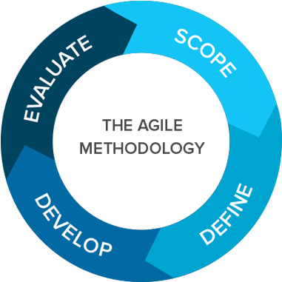
Methodologies
AGILE:
Cycling through phases of planning, design,
development, testing and deployed
Continual improvement through iterative work, changes and updates
The project team and stakeholders are in constant communication, repeatedly evaluating and completing work in a cyclical nature.
Results in gradual but continual improvement. It’s ongoing, more flexible and adaptable to change, producing outcomes faster and improving them over time.

Slide 13
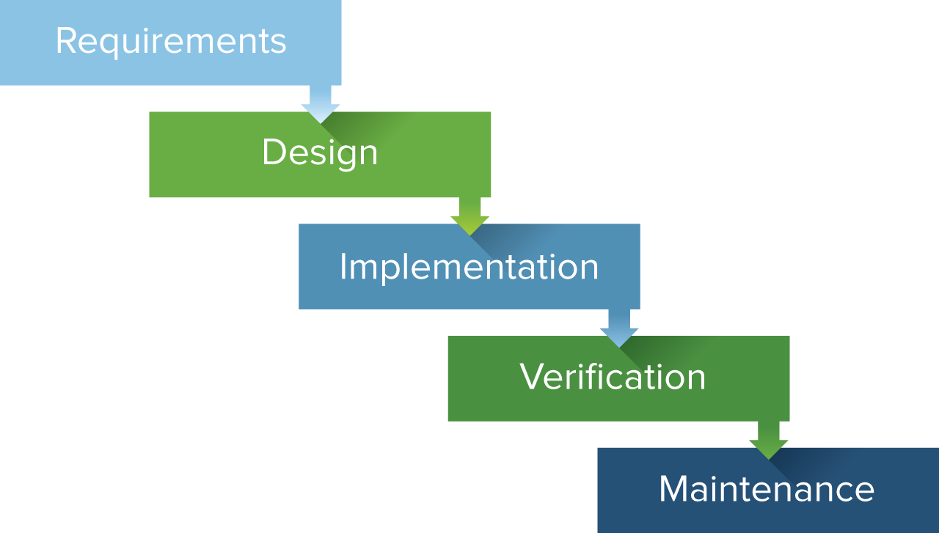
Methodologies
Waterfall:
a sequential development process that flows
like a waterfall through all phases of a project
(analysis, design, development, and testing, for
example), with each phase completely wrapping up
before the next phase begins.
The success of the Waterfall method depends on the amount and quality of the work done on the front end, documenting everything in advance, including the user interface, user stories, and all the features’ variations and outcomes.
The total cost of the project can be accurately estimated, as can the timeline, after the requirements have been defined.

Slide 14
Documentation
Process of recording the key project details and producing the documents that are required to implement it successfully.
Project documents come in many forms – from project proposals and business cases, project plans, UI design and blueprints, Codes, project status reports etc.
Documentation is very important for both client and developer.
Technology
Technology should be adopted which will best serve the purpose.
Developer should be flexible enough to swich to the best and most updated version.
Use frameworks such as Laravel, .Net, Bootstrap instead of writing codes from scratch.

Slide 15
Coding Standards
Understandability is very important.
Code should be well documented.
Use well defined and well optimised functions for specific tasks.
Project Management
Project manager is needed.
Maintain constant communication and understanding between client and developer.
Effort synchronization.
Code Collaboration : Github

Slide 16
CONTENTS
Company Overview
Software Development Process
Learnings
Achievements

Slide 24
About Nascenia
Nascenia has won multiple prestigious awards over the years for their works.
BASIS outsourcing award winner 2015 and 2014
2013 Red Herring top 100 Asia winner
2012 Red Herring top Asia finalist
eAsia ( www.e-asia.org ) award winner in 2011
Grameen Phone - Microsoft Alo Asbei award winner in 2010

